Slide 1
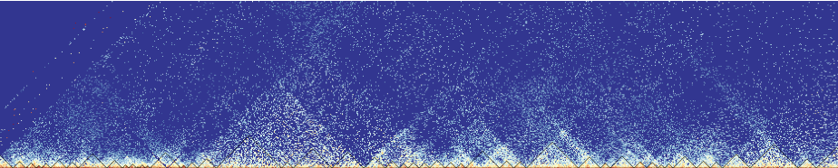
Homer, HiC, and Harnesses
Rotation Project by Jameson Blount

Slide 2
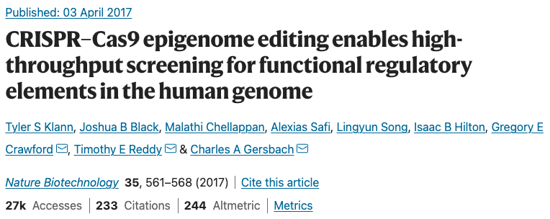
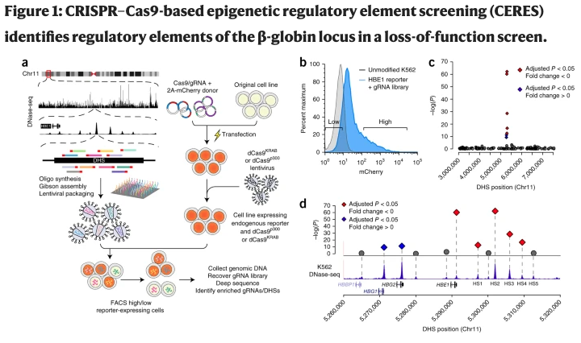
Notes:
Broadly speaking, the goal of the CERES study re there reg. elements that have effect on proliferation that are independent of protein coding…redundancy may have an effect on it
Investigates designed and synthesized gRNA libraries to target all candidate gene regulatory elements in a genomic region, in this case as defined by DHSs identified by DNase-seq. Lentiviral vectors encoding the gRNA library are delivered to cell lines that express the dCas9^{KRAB} repressor for loss-of-function screens, or the dCas9^{p300} activator for gain-of-function screens. The cells can then be selected for changes in phenotype, such as gain or loss of expression of a target gene. Sequencing the gRNAs in the selected cell subpopulations and mapping them back to the genome reveals the regulatory elements involved in controlling the selected phenotype. In the example shown here, they designed gRNAs to all DHSs in a 4.5-Mb region surrounding the β-globin locus, and introduced into human K562 cells expressing dCas9^{KRAB} and containing an mCherry reporter at HBE1.
(b) Representative flow cytometry data for the HBE1 reporter cells containing the gRNA library, and expression levels (low versus high) of cells sorted for gRNA enrichment.
(c) Manhattan plot of a high-throughput screen for regulatory elements in the 4.5 Mb surrounding the globin locus, using the dCas9^{KRAB} repressor.
(d) Enriched DHSs after selection for decreased HBE1 expression were found only in the HBE1 promoter and enhancers (HS1–4), whereas the promoters of HBG1/2 were enriched in cells with increased HBE1 expression. Diamonds and circles in c and d represent individual DHSs; gray circles represent adjusted P > 0.05. Red indicates DHS fold change < 0, and blue indicates DHS fold change > 0.
In addition to providing the degree to which each DHS was enriched, the dataset also provides other characteristics of these DHSs such as the category of the DHS according to chromHMM, the closest gene to a given DHS, if this gene is essential according to other literature, GC/repeat content of the DHS sequence, etc
Here, the degree to which proliferation altered is used as a proxy for essentiality

Slide 3
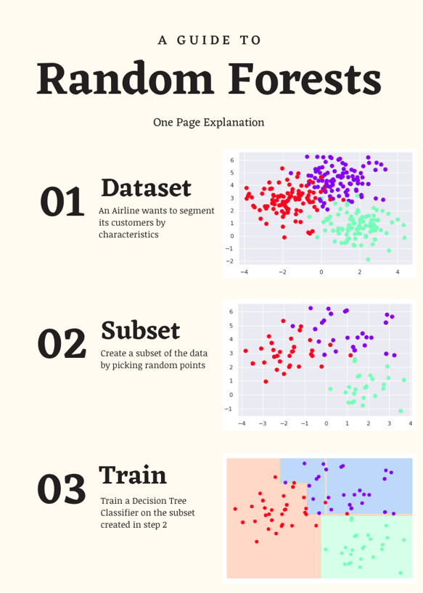
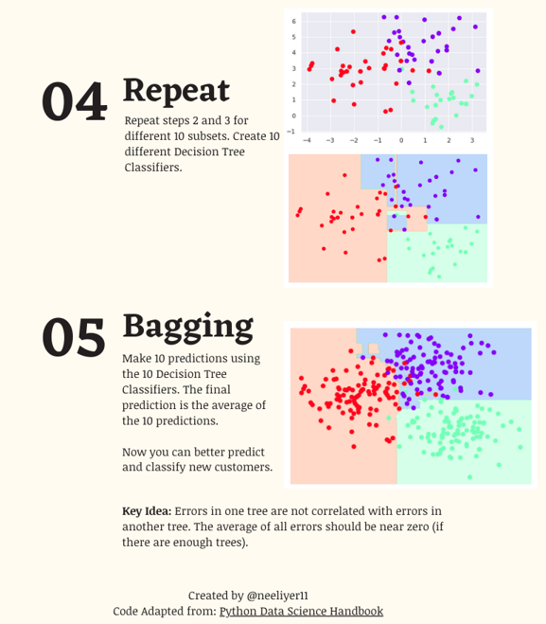
Notes:
In a past set of in silico experiments, Carl investigated which of the previously described characteristics were the best predictors for essential DHSs using Random Forest machine learning
Bagging, also known as Bootstrap aggregating, is an ensemble learning technique that helps to improve the performance and accuracy of machine learning algorithms. It is used to deal with bias-variance trade-offs and reduces the variance of a prediction model
We see that this strategy to reduce variance succeeds, demonstrated through the following experiments

Slide 4
PhyloP scores
measure evolutionary conservation at individual alignment sites
From 1 bp resolution, chose to average scores across each individual DHS using “bedtools map” function
Chose 3 different versions as comparison:
242-way mammalian
46-way primates
46-way placental
Notes:
We were interested in adding evolutionary conservation as another characteristics to the CERES dataset
Why would phyloP be a confounder in this case?
Conserved == functionally significant
PhyloP scores can be interpreted as the evolutionary conservation of this region compared to the evolution expected under neutral drift.
Positive scores — indicate conservation, which is slower evolution than expected, at sites that are predicted to be conserved.
Negative scores — indicate acceleration, which is faster evolution than expected, at sites that are predicted to be fast-evolving
These can be found on the UCSC genome database, but at single nucleotide resolution
In order to characterize the conservation of a particular DHS, used bedtools map function to average the phyloP score for that region
In the following plots, I will compare how the set of predictors, with and without the phyloP scores, performed using four different response vectors

Slide 5
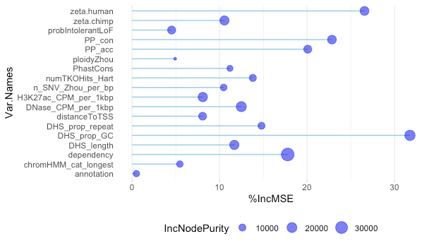
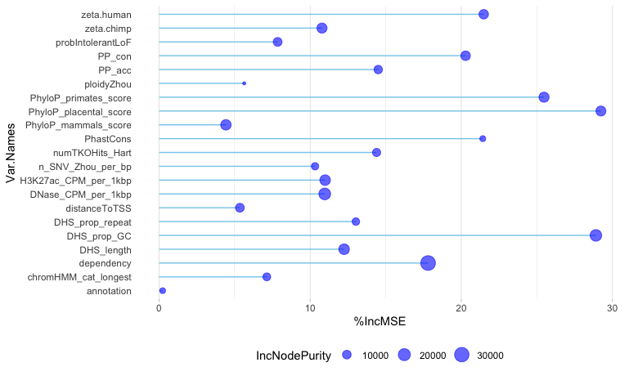
Whole-genome CERES score as the response vector
Excluding phyloP scores
Including phyloP scores
Notes:
Explain what these plots are showing
This response vector represents the sum of log2 fold changes in the DHS
Importance is shown by both the size of the dot and the length of the line
Percentage increase in mean square error is analogous to accuracy-based importance
Increase in node purity represents a kind of importance that measures the average gain of purity by splits of a given variable… If the variable is useful, it tends to split mixed labeled nodes into pure single class nodes at each partitioning
Is there an artifact in the placental scores that is causing that, since the decrease in IncNodePurity is largest here

Slide 6
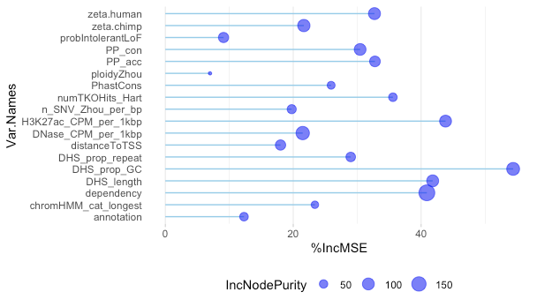
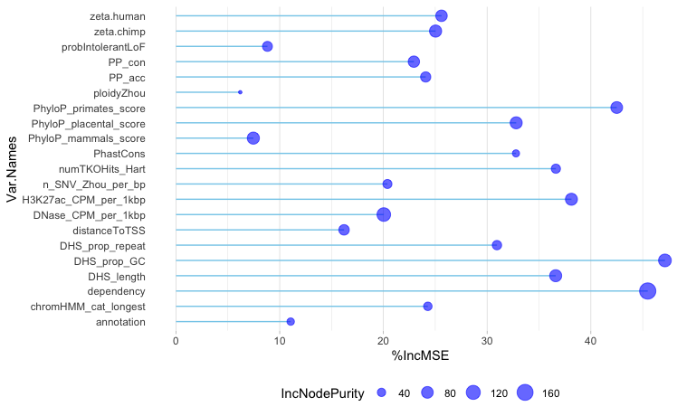
Was DHS (all gRNAs grouped) significant across all DHSs?
Excluding phyloP scores
Including phyloP scores

Slide 7
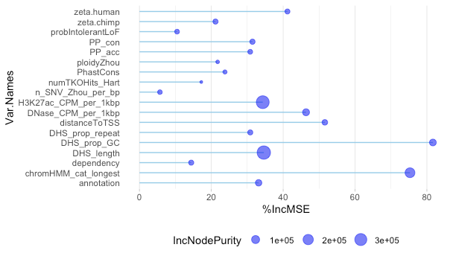
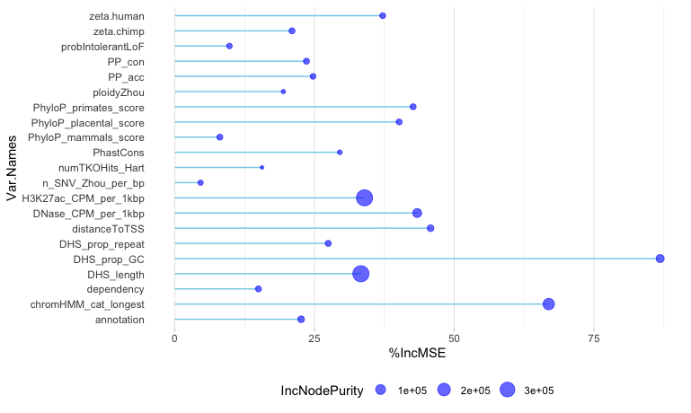
p-value of change in log-fold expression as response vector
Excluding phyloP scores
Including phyloP scores

Slide 8
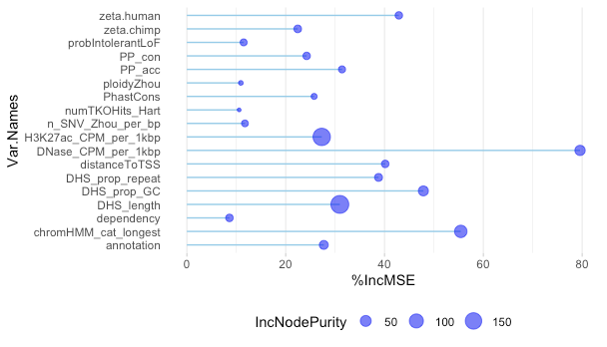
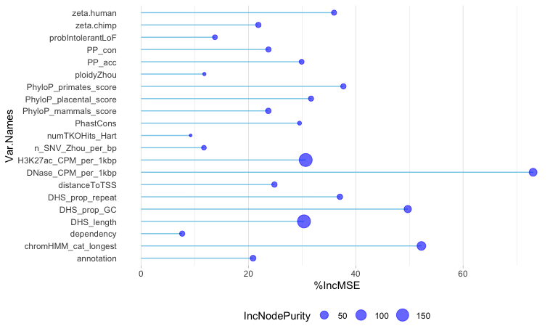
SignalVal - continuous measurement of overall (usually, average) enrichment for the region
Excluding phyloP scores
Including phyloP scores

Slide 9
Are the phyloP scores individually predictive?
Beginning with the 242-way mammalian phyloP scores

Slide 10
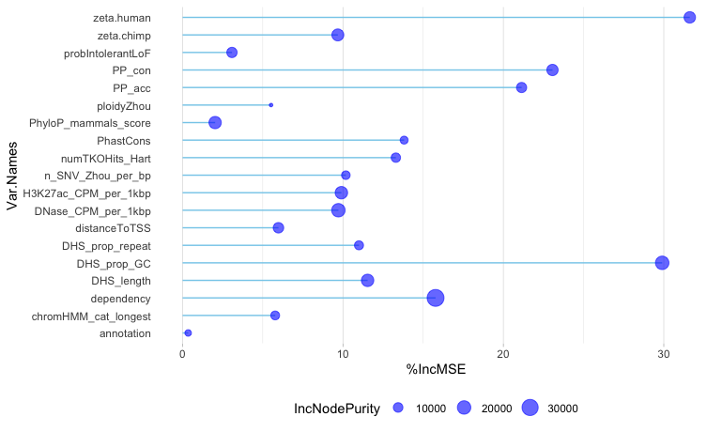
Whole-genome CERES score as the response vector
Excluding phyloP scores
Including 242-mammalian phyloP scores

Slide 11
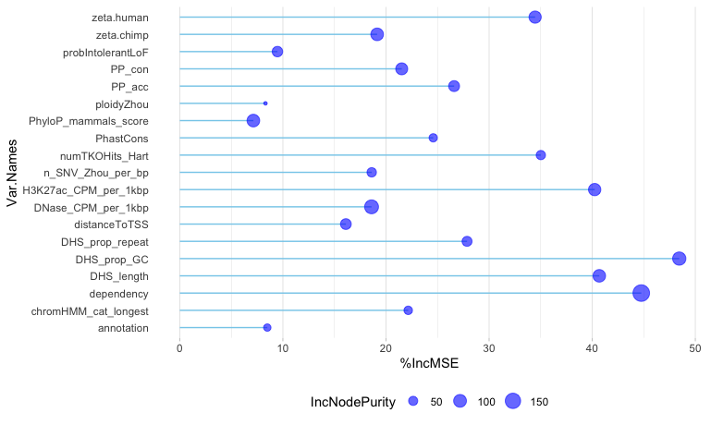
Was the DHS (all gRNAs grouped) significant across all DHSs?
Excluding phyloP scores
Including 242-mammalian phyloP scores

Slide 12
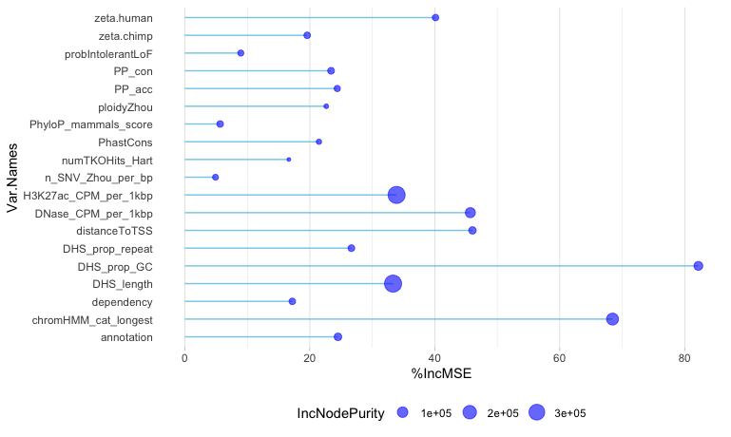
p-value of change in log-fold expression as response vector
Excluding phyloP scores
Including 242-mammalian phyloP scores

Slide 13
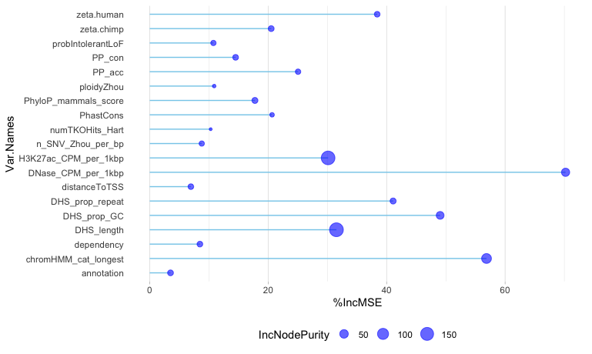
SignalVal - continuous measurement of overall (usually, average) enrichment for the region
Excluding phyloP scores
Including 242-mammalian phyloP scores

Slide 14
Are the phyloP scores individually predictive?
Next, the 46-way primate phyloP scores

Slide 15
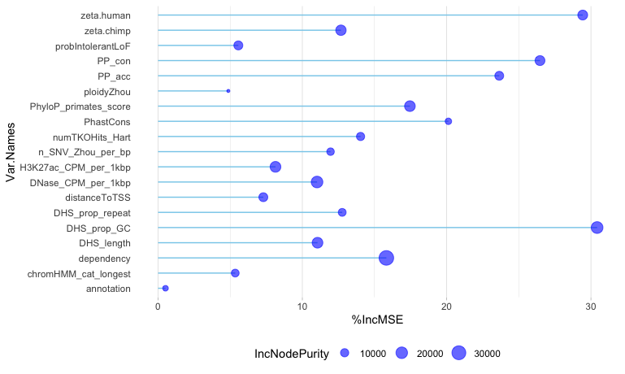
Whole-genome CERES score as the response vector
Excluding phyloP scores
Including 46-way primate phyloP scores

Slide 16
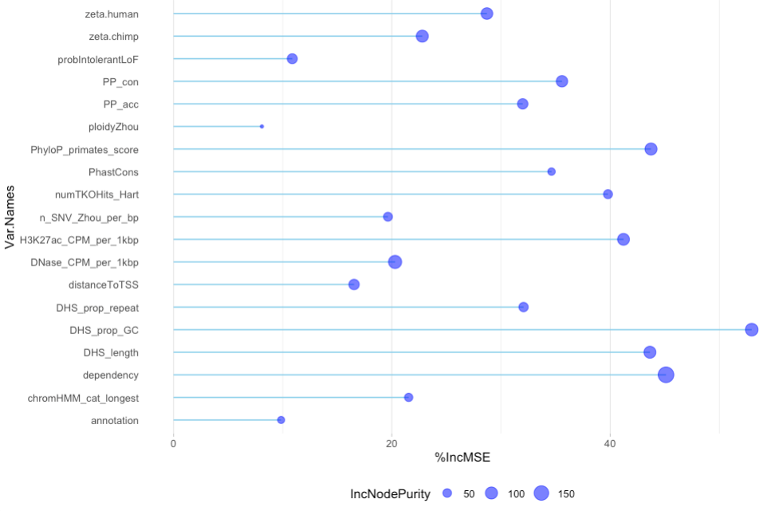
dhsWGsig Forest - dhs_0_1_wg (0,1: was DHS (all gRNAs grouped) significant across all DHSs?) as response vectors
Excluding phyloP scores
Including 46-way primate phyloP scores

Slide 17
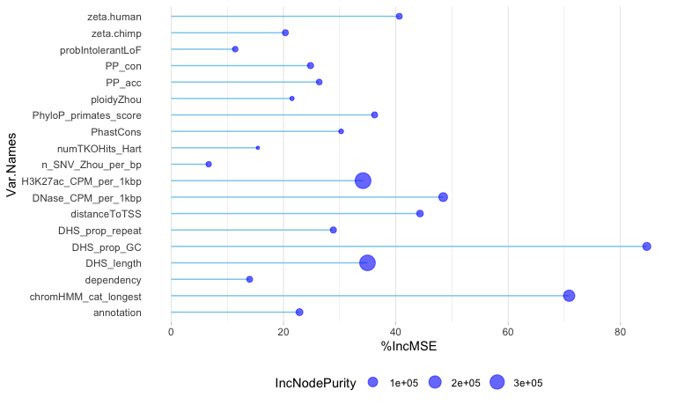
pVal Forest –p-value of change in log-fold expression as response vector
Excluding phyloP scores
Including 46-way primate phyloP scores

Slide 18
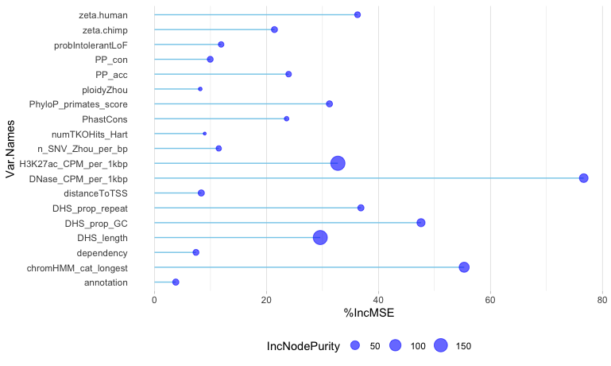
SignalVal - continuous measurement of overall (usually, average) enrichment for the region
Excluding phyloP scores
Including 46-way primate phyloP scores

Slide 19
Are the phyloP scores individually predictive?
Next, the 46-way placental phyloP scores

Slide 20
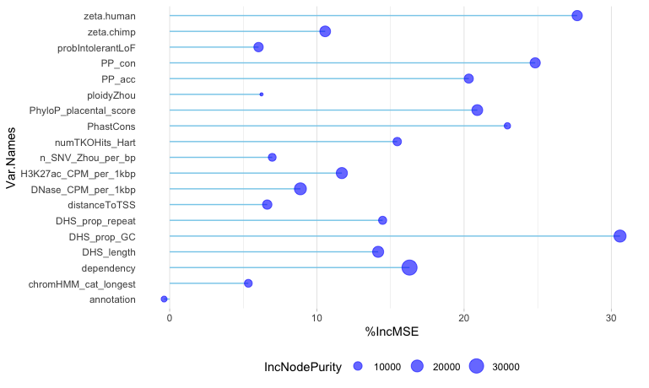
Whole-genome CERES score as the response vector
Excluding phyloP scores
Including 46-way placental phyloP scores

Slide 21
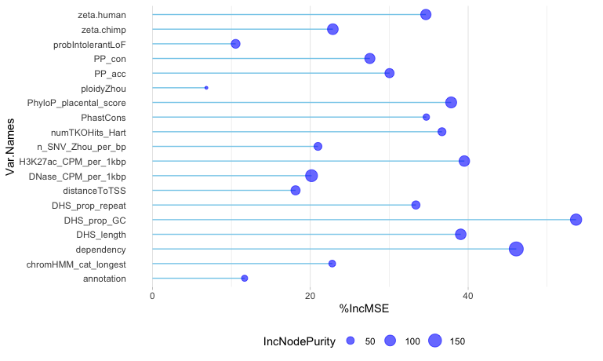
Was the DHS (all gRNAs grouped) significant across all DHSs
Excluding phyloP scores
Including 46-way placental phyloP scores

Slide 22
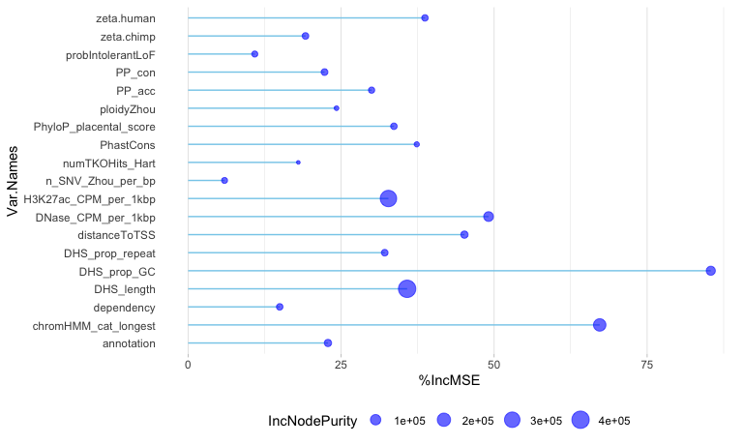
p-value of change in log-fold expression as response vector
Excluding phyloP scores
Including 46-way placental phyloP scores

Slide 23
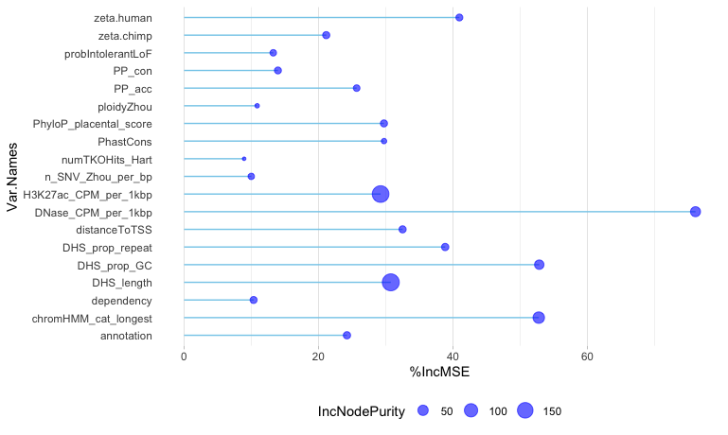
SignalVal - continuous measurement of overall (usually, average) enrichment for the region
Excluding phyloP scores
Including 46-way placental phyloP scores

Slide 24
Deleted the “most important” predictors, i.e. DHS_prop_GC and zeta.human, to observe sensitivity of the model

Slide 25
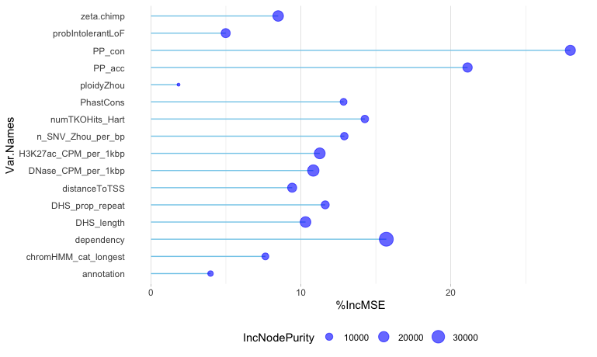
Whole-genome CERES scores as the response vector
Original
DHS_prop_GC and zeta.human removed

Slide 26
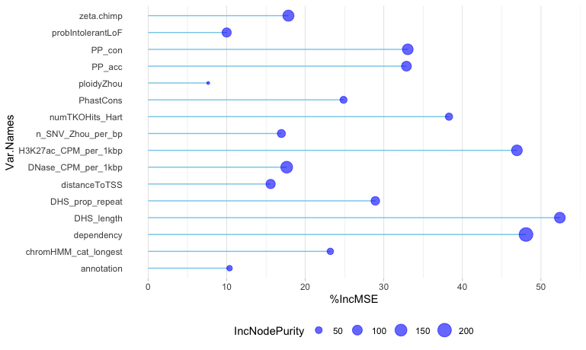
Was DHS (all gRNAs grouped) significant across all DHSs
Excluding phyloP scores
DHS_prop_GC and zeta.human removed

Slide 27
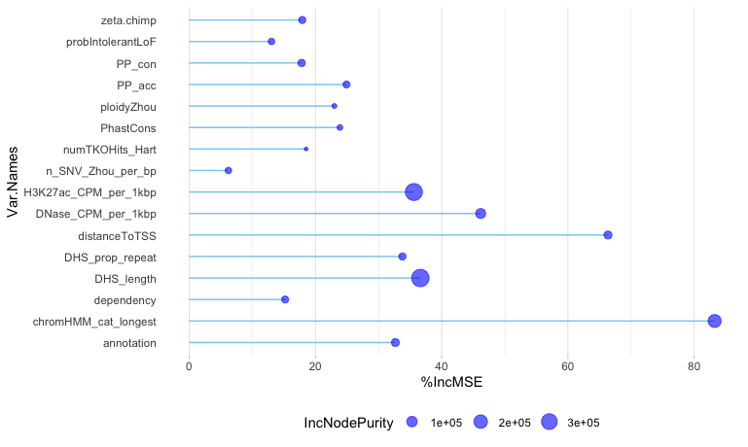
p-value of change in log-fold expression as response vector
Excluding phyloP scores
DHS_prop_GC and zeta.human removed

Slide 28
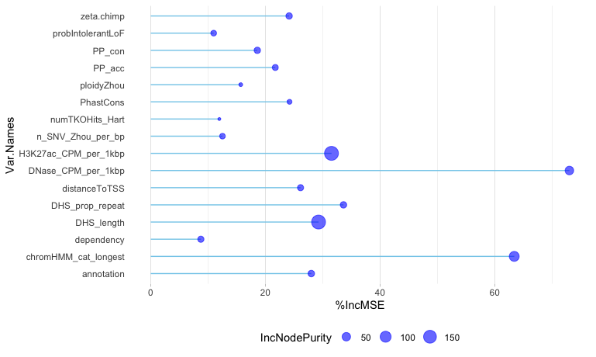
SignalVal - continuous measurement of overall (usually, average) enrichment for the region
Excluding phyloP scores
DHS_prop_GC and zeta.human removed

Slide 29
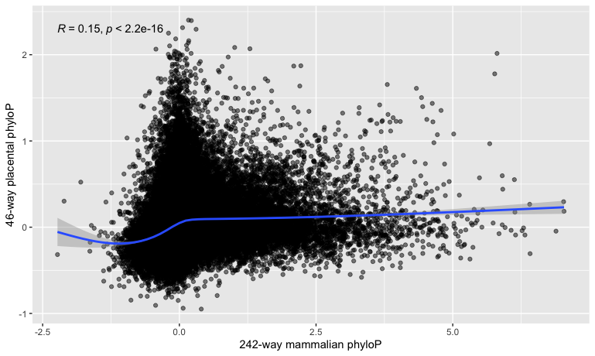
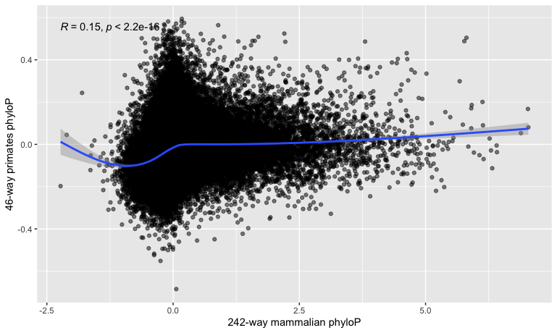
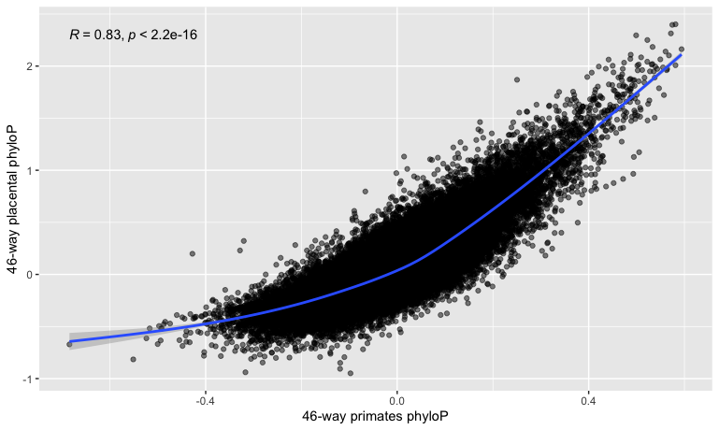
PhyloP comparison scatterplots
Notes:
Color these by chromHMM_cat_longest, see distribution of core promoters and distal enhancers…does the number of core promoters a gene has correlation to essentiality, as well as enhancers

Slide 30
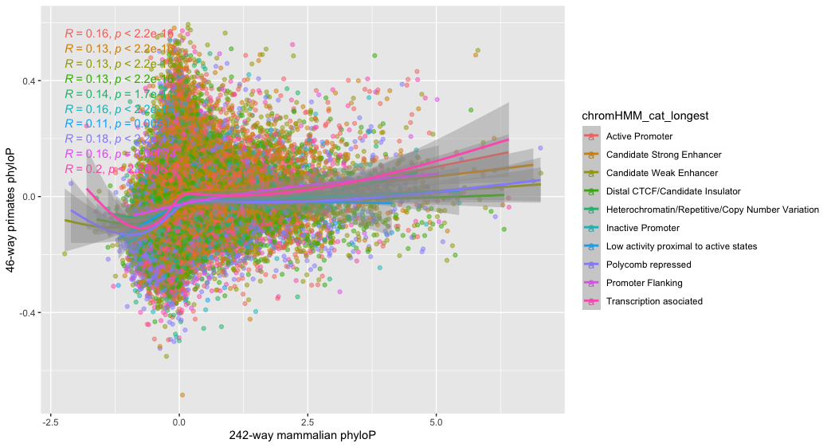
PhyloP comparison scatterplots: chromHMM_cat_longest
Notes:
Color these by chromHMM_cat_longest, see distribution of core promoters and distal enhancers…does the number of core promoters a gene has correlation to essentiality, as well as enhancers
What does trans assoc mean?
Includes: Active TSS, Flanking Active TSS, Transcription at gene 5’ and 3’, Strong Transcription, Weak transcription…unfortunately not explicitly documented, based on my own conjecture of the original chromHMM catgories

Slide 31
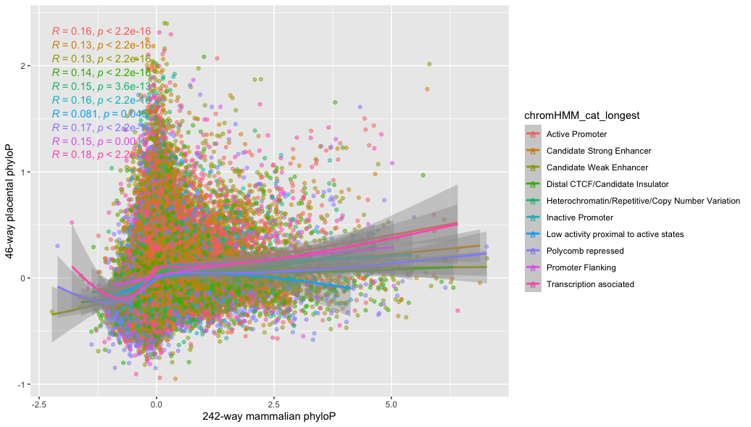
PhyloP comparison scatterplots: chromHMM_cat_longest
Notes:
Color these by chromHMM_cat_longest, see distribution of core promoters and distal enhancers…does the number of core promoters a gene has correlation to essentiality, as well as enhancers

Slide 32
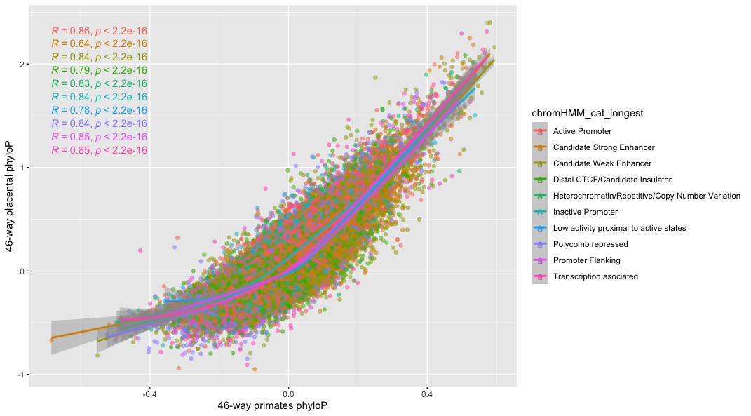
PhyloP comparison scatterplots: chromHMM_cat_longest
Notes:
Color these by chromHMM_cat_longest, see distribution of core promoters and distal enhancers…does the number of core promoters a gene has correlation to essentiality, as well as enhancers
Less noise here, intuition is the deeper you go the less information you have (opposite of what you would expect)…these depths are concordant meaning: interchangeable
In a coding sequence, intuition would hold that more conserved == more functional
Can we attach an interpretation to the CERES result…GC content, motif-mapping with HOMER..deep evolutionary conservation is not helpful, medium is, but what about GC content, motif enrichment
GC content is less likely to melt…separate core promotors…core promotors are AT-rich…to regulate DNA no melting required…pull OCRs by chromHMM and just compute GC on whole thing, compare…concatenate and character count (or just use word count –c from terminal for those, count tables, aggregated A’s and T’s, and G and C’s) is what we’re seeing here
Hyp1: These regions have high GC content because messing with the core promoters = no transcription, but enhancers are redundant and can compensate…less motif and more base composition perhaps?
Motif enrichment: we know transcription factors thanks to RNA-seq, can we sus out master trans factors for each cell type, motif for K562 (liver-derived), look for it among the 4-5 hepatic master transcription factosr: Hyp 2: their motifs are skewed GC/AT rich

Slide 33
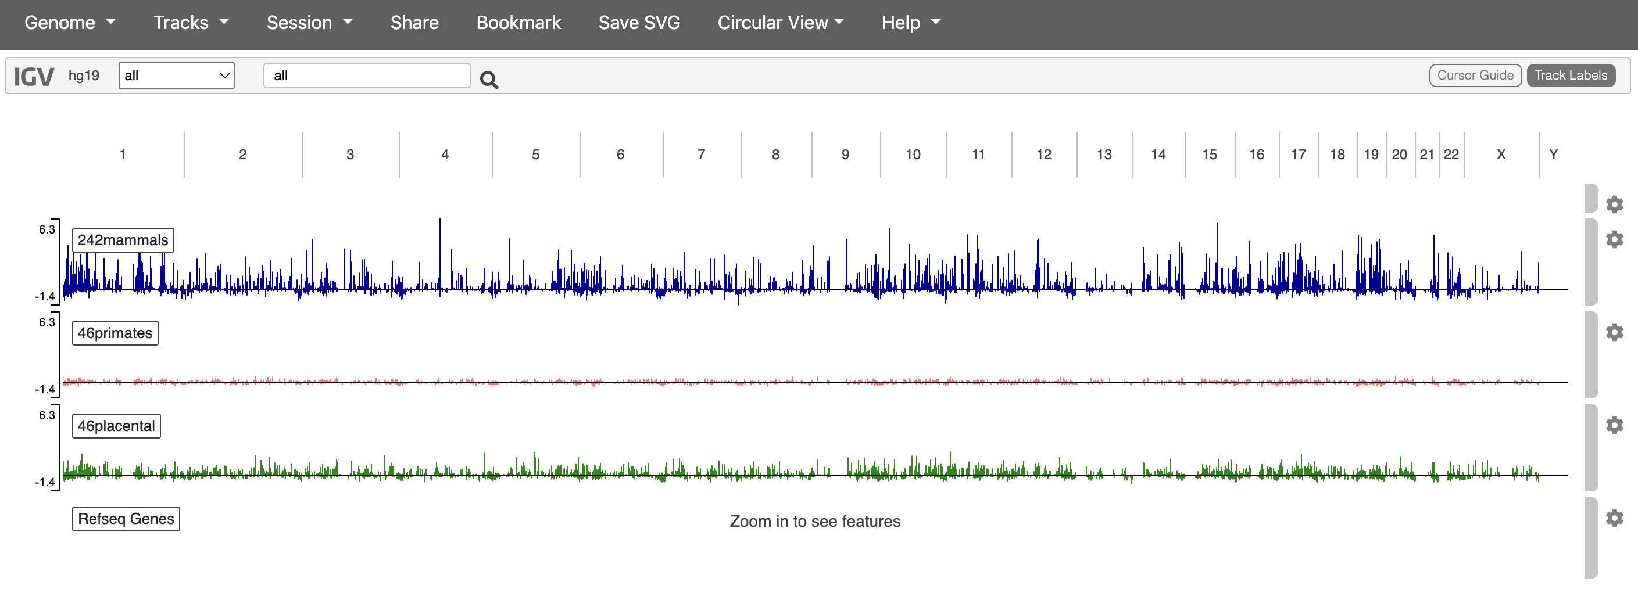
IGV view of phyloP scores vs. genomic location
Notes:
These appear opposite of the intuition…
Measure of disparity causes this huge difference in scale between types of phyloP scores
Take top/bottom 10%/quintile phyloP , look at the properties of these
Why do the conservation scores matter so little to the RF???
RF is robust to noise(?)

Slide 34
Lessons learned
The metric scoring the most deeply conserved regions was the least informative for predicting DHS proliferation, and the primate phyloP score was the most informative
The model is robust to the number the of predictors – low variance
Active promoters, enhancers, and transcription associated DHSs tend to have higher phyloP scores
Notes:
How little the longer-standing phyloP scores…prevailing wisdom doesn’t hold for non-coding regulatory sequences…single mutations degenerate genes, but not necessarily true with regulatory elements

Slide 35
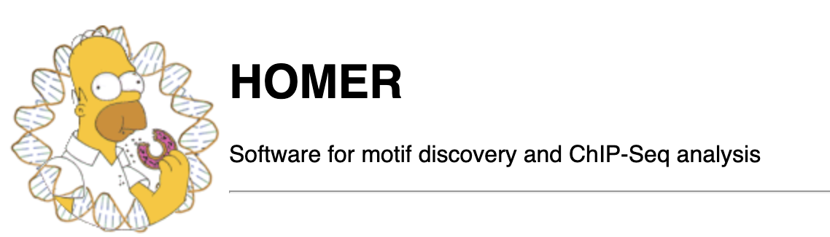
Motif enrichment
In the RF modeling, GC content consistently had high percent increase in MSE
Is GC content alone predictive of important DHSs, or have we stumbled onto a specific TF?
Notes:
Can we attach an interpretation to the CERES result…GC content, motif-mapping with HOMER..deep evolutionary conservation is not helpful, medium is, but what about GC content, motif enrichment
GC content is less likely to melt…separate core promotors…core promotors are AT-rich…to regulate DNA no melting required…pull DHSs by chromHMM and just compute GC on whole thing, compare…concatenate and character count (or just use word count –c from terminal for those, count tables, aggregated A’s and T’s, and G and C’s) is what we’re seeing here
Hyp1: These regions have high GC content because messing with the core promoters = no transcription, but enhancers are redundant and can compensate…less motif and more base composition perhaps?
Motif enrichment: we know transcription factors thanks to RNA-seq, can we sus out master trans factors for each cell type, motif for K562 (liver-derived), look for it among the 4-5 hepatic master transcription factosr: Hyp 2: their motifs are skewed GC/AT rich

Slide 36
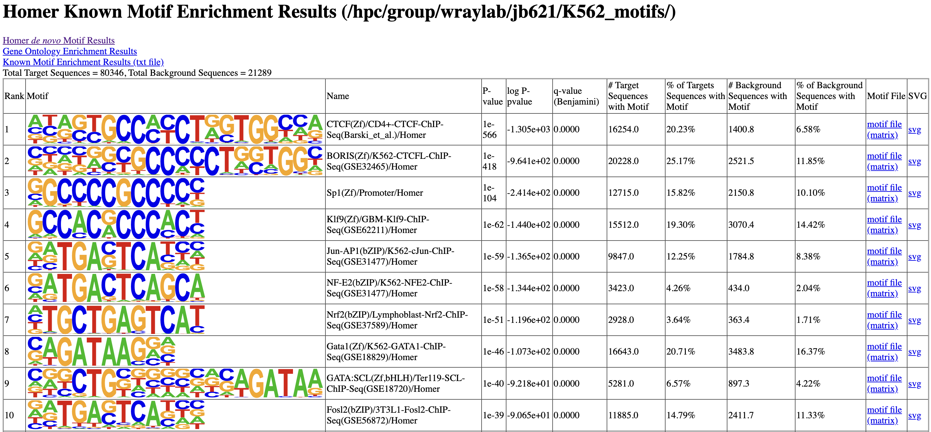
DHS sequence attributes – lncRNA Hg19 background
Aggregated chromHMM category | Average % GC | Average % AT
Promoter | 0.512 | 0.488
Enhancer | 0.596 | 0.404
Notes:
As background, pull DHS sites from different cell types (neuron, endo/ecto dermal cells for example) that Alejo could give you.
Jun and Fos – possibly a marker for more dynamic activity
Both enriched and changed on branch in correlated way
Sibbata et al (Greg Crawford, ATAC-seq comparative chromatin paper)

Slide 37
chromHMM and CERES scores of the DHS’s containing the Jun and Fos HOMER motifs
chromHMM category | Jun-AP1 (-TGACTCAT) motif | Fos2 (GATGACTCA-) motif
Active Promoter | 246 (0.134) | 65 (0.103)
Candidate Strong Enhancer | 655 (0.356) | 245 (0.389)
Candidate Weak Enhancer | 523 (0.284) | 193 (0.306)
Distal CTCF/Candidate Insulator | 119 (0.065) | 28 (0.044)
Heterochromatin/Repetitive/Copy Number Variation | 51 (0.028) | 12 (0.019)
Inactive Promoter | 40 (0.022) | 13 (0.021)
Low activity proximal to active states | 13 (0.007) | 5 (0.008)
Polycomb repressed | 123 (0.067) | 47 (0.075)
Promoter flanking | 10 (0.005) | 1 (0.002)
Transcription associated | 61 (0.033) | 21 (0.033)
CERES_wg_nosig | 0.2077 | 0.1887
46-way primate PhyloP | -0.0028 | -0.0017
Notes:
Subsetting by the previous motifs, see whether that is well/not-well conserved (primate specifically)…problem is we don’t have
Alejo could give you OCRs that are open in other cell types, not unique to a particular cell type: http://genome.ucsc.edu/cgi-bin/hgTables?hgsid=1396517773_cxAsIILdDYP7AXC7WavnPJ0yKXrE&clade=mammal&org=Human&db=hg19&hgta_group=regulation&hgta_track=wgEncodeOpenChromDnase&hgta_table=wgEncodeOpenChromDnaseCerebellumocPk&hgta_regionType=genome&position=chrX%3A15%2C578%2C261-15%2C621%2C068&hgta_outputType=primaryTable&hgta_outFileName=phyloP_241mammalsv2
JASPER, what is Jas, Ap1 consensus, allow 1-2 mismatches search for that
Primate phyloP score correlation and presence/absence of motif
Compare CERES score between GC-rich motifs (for TFs) and just a random GCrich sequence (AND nonGCrich)
As background, pull DHS sites from different cell types (neuron, endo/ecto dermal cells for example) that Alejo could give you.
Jun and Fos – possibly a marker for more dynamic activity
Both enriched and changed on branch in correlated way
Sibbata et al (Greg Crawford, ATAC-seq comparative chromatin paper)

Slide 38
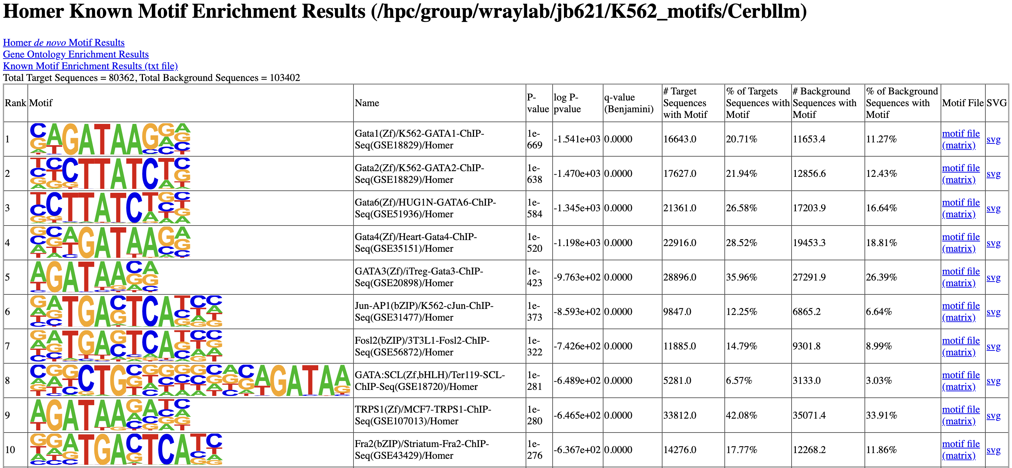
DHS sequence attributes – Crbllm DHS’s background
Aggregated chromHMM category | Average % GC | Average % AT
Promoter | 0.512 | 0.488
Enhancer | 0.596 | 0.404
Notes:
These are well-studied heterodimer TFs…interesting due to between-species ATAC-seq study, suggesting they act as a pioneer site for opening/closing OCR…one SNP could lose you the whole enhancer…it is epistatic to the others, if its not first then all the others will not follow…
are Fos Jun pioneer TFs? If yes, binding sites for them are more sensitive to having an effect on gene expression
Investigate those as well
Pioneer binding sites are something that we should be paying attention…if we take other pioneer factors, now predict they’re important, would we see the same enrichment…looking at which pioneer factors are tissue-specific and making sure that matches with our expectations

Slide 39
Are Jun-AP1 and Fosl2 pioneer TFs?
“Cellular senescence…controlled by the pioneer transcription factor AP-1” (Zumerle S, Alimonti A (2020))
“AP-1 hotspots are predictive of cell-type specific gene expression” (Seo J et al. (2021))

Slide 40
Checking assumptions with HiC
Is there a systematic bias in misassignments of non-coding element to gene? That’s what the HiC is hoping to answer
Using HiCExplorer to find topologically associating domains (TADs), verify this assignment
Further characterize the essentiality of these elements
Notes:
The usual assumption, that the core promoter/enhancer is adjacent/close to the gene it interacts with, is worth investigating
HiC is particularly poised to interrogate this assumption by providing topologically associating domains (TADs)
Using just TAD boundaries, could be able to see if both open core promoter and enhancer are in the same TAD…take bed files and see if they’re in the same TAD…

Slide 41
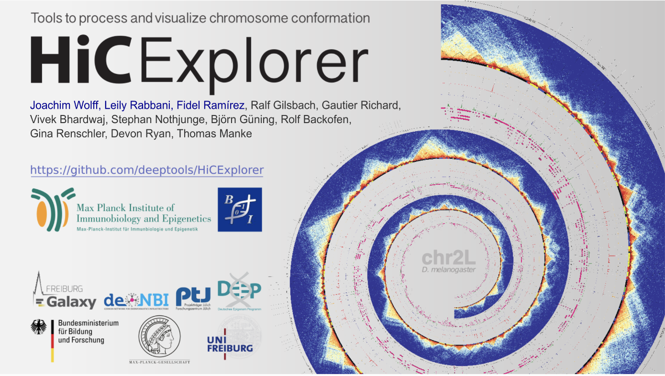

Slide 42
HiC Results – 1st replicate
Notes:
Restrict other HiC replicates, and pool them to get higher res…just present one chromosome as a target for mapping …would be improved by expression data

Slide 43
Hi-C Results – all 3 replicates
Notes:
Are the black wavy lines uncertainty
Closest core promoter
Activity by contact, core promoter , weight DHSs, summing all beta values from the screen

Slide 44
Hi-C results – all 3 replicates, threshold adjusted

Slide 45
Going a step further with Machine Learning Harnesses
Compare performances of ML techniques between top and bottom quartile of DNase-seq peak size using the same metrics between different ML techniques
Mean Absolute Error (MAE)
Mean Squared Error (RMSE)
Compare performances of ML techniques using original DHSs and removing DHSs that aren’t contacting any core promoter
Two models for each of the two types of response vectors
Notes:
If not, that throws into question what seeing that peak really means, some small peaks could be very influential, also depends on when in the cell cycle you see an ATAC-seq peak…peaks are called by averaging against all other cells that don’t have those peaks

Slide 46
Comparing ML performance for quartiles of DNase-seq score using Harnesses
Quartile | Machine Learning Technique | Error Metric | CERES score as response
Upper | Linear Model | MAE | 1.61
 |  | RMSE | 2.87
 | Gradient Boosted Machine | MAE | 1.60
 |  | RMSE | 2.86
Lower | Linear Model | MAE | 1.16
 |  | RMSE | 1.49
 | Gradient Boosted Machine | MAE | 1.16
 |  | RMSE | 1.49
Notes:
ATAC-seq peaks have left-skewed distribution…peaks are barely above noise…how often are the peaks being miscalled…progressively enriched for false-positive/negatives…are the smaller peaks actually functional though, when we do find them? Partitioning peaks into bins/quartiles to look at whether ML approaches are getting more

Slide 47
Comparing ML performance for quartiles of DNase-seq score using Harnesses
Quartile | Machine Learning Technique | Error Metric | Significant DHS as response
Upper | Logistic Regression | MAE | 0.06
 |  | RMSE | 0.24
 | Support Vector Machine | MAE | 0.06
 |  | RMSE | 0.24
Lower | Logistic Regression | MAE | 0.02
 |  | RMSE | 0.12
 | Support Vector Machine | MAE | 0.02
 |  | RMSE | 0.12
Notes:
ATAC-seq peaks have left-skewed distribution…peaks are barely above noise…how often are the peaks being miscalled…progressively enriched for false-positive/negatives…are the smaller peaks actually functional though, when we do find them? Partitioning peaks into bins/quartiles to look at whether ML approaches are getting more

Slide 48
Comparing ML performance for DHS’s within TADs with confirmed interaction
Dataset | Machine Learning Technique | Error Metric | CERES score as response
Unfiltered | Linear Model | MAE | 1.28
 |  | RMSE | 2.00
 | Gradient Boosted Machine | MAE | 1.29
 |  | RMSE | 1.99
TAD-confirmed | Linear Model | MAE | 1.30
 |  | RMSE | 2.06
 | Gradient Boosted Machine | MAE | 1.30
 |  | RMSE | 2.05

Slide 49
Comparing ML performance for DHS’s within TADs with confirmed interaction
Dataset | Machine Learning Technique | Error Metric | Significant DHS as response
Unfiltered | Logistic Regression | MAE | 0.03
 |  | RMSE | 0.16
 | Support Vector Machine | MAE | 0.03
 |  | RMSE | 0.16
TAD-confirmed | Logistic Regression | MAE | 0.03
 |  | RMSE | 0.16
 | Support Vector Machine | MAE | 0.03
 |  | RMSE | 0.16

Slide 50
Overall Conclusions
Depth of phylogenetic comparison defies expectations
The RF model helped us to identify a couple TFs that are indeed important for transcription
Hic reduces signal to noise, but by how much?
ML harness approach unable to detect significant differences in model predictions
Notes:
HiC is collected at a single timepoint, so while it is informative for the interactions at that timepoint, it is a limited view of interactions
HiC experiments are expensive and the data is large
Expression data (RNA-seq) are typically paired with HiC to give a truly 3D picture of the genome, and the next CERES experiment will supposedly do this

Slide 51
Future Directions
Use HiC to correct misassigned enhancers
Perform differential HiC analysis, i.e differential TAD boundaries, testing significant interactions
Integrate results into the RF model presented here
Use the next iteration of CERES data to fine-tune RF models
Notes:
Closest TSS assumption is the acting,
in that cell type, might be OCR, but not looping = not active…tells us nearby gene loops
Remove non-lopping OCRs, correct ones that are looping, accurate assigning to gene(s) (more than 2)…better way of finding correlate between OCRs and gene
Finding essentiality of promoter based on enhancer
Stratify OCRS by their place in TADs, structuring the approach informs

